Slide 1




BY ANKITA KALA

Slide 2
Introduction Unilever is a British-Dutch multinational consumer goods company headquartered in London, England. Unilever products include food, condiments, bottled water, baby food, soft drink, ice cream, instant coffee, cleaning agents, energy drink, toothpaste, pet food, pharmaceutical and consumer healthcare products, tea, breakfast cereals, beauty products, and personal care. Unilever is the largest producer of soap in the world. and its products are available in around 190 countries. Unilever's largest brands include Lifebuoy, Dove, Knorr, Lux, Sunlight, Rexona/Degree, Axe/Lynx, Ben & Jerry's, Omo/Persil, Heart brand (Wall's) ice creams, Hellmann's and Magnum.

Slide 3
Business Analysis Core Concept Model (BACCM)
FOR LIVE VIEW HERE

Slide 4

Task 1: Identify Stakeholders
Internal Stakeholders
External Stakeholders
Stakeholder | Key Responsibilities
Project Manager | Leads the project from planning through deployment Serves as the primary decision-maker
Domain SME | Provides domain expertise Guides the Implementation SME in solution design and development
Implementation SME | Develops the web-based application under the guidance of the Project Manager and Domain SME
Tester | Conducts quality analysis Verifies that the application meets requirements and is defect-free before deployment
IT Support | Coordinates operational tasks across departments Manages calendars and logistics to ensure timely completion of tasks
Business Analyst | Acts as the communication bridge between internal and external stakeholders Elicits requirements, identifies gaps, and proposes solutions
Stakeholder | Key Responsibilities
Employee | Places orders and receives delivery at their workstation Saves lunch time and boosts productivity Tracks personal food expenses for budgeting Chooses favourite meals
Canteen Manager | Views incoming orders and procures ingredients accordingly Maintains order history to support standard operating procedures Assigns deliveries to food-delivery executives
Chef | Prepares meals according to received orders Manages kitchen workflow and timing
Food Delivery Executive | Monitors order preparation status Retrieves workstation details and delivers orders
Payroll Manager | Receives consolidated invoices with employee order details Applies food-order charges to employee payroll
Unilever Management | Reviews employee feedback on the canteen service Identifies areas for continuous improvement

Slide 5

Stakeholder Onion Diagram
Solution Delivery - Business Analyst, Project Manager, Implementation Manager, Tester
Affected Organizational Unit- Operational/IT Support, Employees, Canteen Manager, Chef, Deliver Executive
Organisation - Unilever Domain SME
Affected External Stakeholders - Payroll Management and Inventory Supplier (Regulator)
FOR LIVE VIEW HERE

Slide 6
RACI MATRIX FOR STAKEHOLDERS
Responsible (R): The person who is directly assigned and will be performing the work on the task
Accountable (A): Person who is accountable for the completion of the task successfully, he/she has a peripheral Involvement like tracking, monitoring and evaluation. Only one stakeholder receives this task.
Consulted (C): Stakeholder or group of stakeholders, who are in loop and are asked to provide an advice/suggestion/information about the task. It is a two- way communication
Informed (I): Stakeholder or group of stakeholders is kept up-to-date about the task and its outcome. Here, the communication is one-way.
Stakeholders | Responsible | Accountable | Consulted | Informed
Supplier | R
Tester | R
Operational support (IT) |  |  | C
Implementation SME |  |  | C
Project Manager |  | A
Canteen Manager | R
Employees |  |  |  | I
Chef | R
Inventory Manager | R
Payroll System |  |  |  | I
Deliverer | R
Business Analyst | R

Slide 7
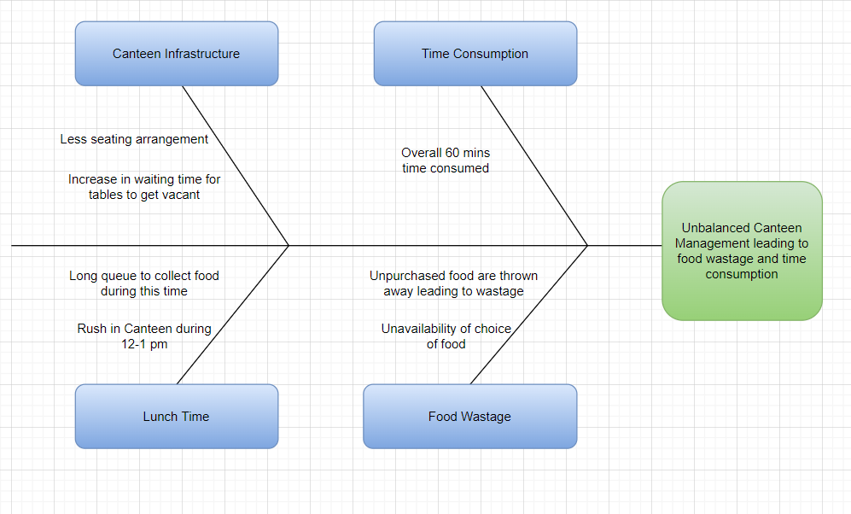
Task 2: Identify Problem Statement
A Fishbone diagram represents the Problem/Root Cause Analysis
Insufficient Capacity
Only two canteens serve 1,500 employees, but just 150 seats are available at any one time.
Peak‐time queues extend wait times, reducing actual eating time and employee satisfaction.
Inconsistent Menu Availability
Popular dishes often sell out because ingredient orders aren’t standardized.
Employees frequently cannot order their preferred meals, leading to frustration.
Excess Food Waste
Unsold food is discarded daily, generating significant waste and financial loss.
Lack of demand forecasting and order procedures exacerbates spoilage.
FOR LIVE VIEW

Slide 8
Task 3: Identify objectives of the new Canteen Ordering System.
Business Objective 1: Reduce Food Wastage
Goal: Decrease food wastage in the canteen by at least 30% within 6 months of system implementation.
Measurement: Compare monthly value of discarded food before and after implementation.
Baseline: 25% food wastage.
Target: Achieve less than 15% food wastage.
Business Objective 2: Lower Operating Costs
Goal: Reduce the canteen’s operational expenses by 15% within 12 months of launch.
Measurement: Track and compare staff, inventory, and utility costs before and after automation.
Business Objective 3: Improve Employee Productivity
Goal: Increase average productive work time by at least 30 minutes per employee per day, within 3 months of system rollout.
Measurement: Monitor time saved from queue reduction and faster ordering via system logs or employee feedback.
Business Objective 4: Optimize Manpower Utilization
Goal: Automate the ordering process and enable food delivery to workstations, allowing the canteen to operate efficiently with reduced staff.
Impact: Reduce dependency on manual order-taking and serving, reallocating human resources to other high-value tasks.

Slide 9
Task 4: BUSINESS DOCUMENTATION
FUNCTIONAL REQUIREMENTS DOCUMENTS
Business Requirement Documents
FR001: Menu Management System
FR001.1: Daily menu creation with items, prices, descriptions
FR001.2: Real-time availability updates
FR001.3: Category-based menu organization
FR001.4: Nutritional information display
Delivery Management
FR004.1: Delivery route optimization
FR004.2: Real-time delivery tracking
FR004.3: Delivery confirmation at employee workstation
FR004.4: Order closure upon successful delivery
BR001: Online pre-ordering system with 11 AM cutoff
BR003: Real-time menu management capability
BR004: Automated payroll deduction integration
BR005: Feedback and rating system
BR002: Desktop delivery to eliminate queuing
BR006: Comprehensive reporting dashboard
FR002: Order Management System
FR002.1: Browse daily menu with search/filter options
FR002.2: Shopping cart functionality (add/edit/remove)
FR002.3: Order placement with 11 AM deadline enforcement
FR002.4: Order confirmation and tracking
FR002.5: Order history and preferences
Payment Integration
FR005.1: Employee enrollment for payroll deduction
FR005.2: Monthly billing calculation and summary
FR005.3: Integration with existing payroll system
FR005.4: Payment history and reports
NON-FUNCTIONAL REQUIREMENTS(NFR)
NON-FUNCTIONAL REQUIREMENTS (NFR)
Performance Requirements
NFR001: Support 1500 concurrent users during peak hours
NFR002: Page load time <3 seconds
NFR003: Order processing time <2 seconds
NFR004: System availability 99.5% during business hours (8 AM - 6 PM)
Scalability Requirements
NFR005: Handle 500+ simultaneous orders (10:30-11:00 AM peak)
NFR006: Database capacity for 12 months historical data
NFR007: Auto-scaling for future growth (up to 2000 employees)
Security Requirements
NFR008: Corporate SSO integration
NFR009: Role-based access control
NFR010: Data encryption (in transit and at rest)
NFR011: Audit trail for all transactions
FR003: Order Processing System
FR003.1: Aggregated order view for kitchen planning
FR003.2: Inventory management integration
FR003.3: Order status updates (Confirmed → Preparing → Ready → Delivered)
FR003.4: Delivery assignment and routing
Feedback System
FR006.1: Order-specific feedback and ratings
FR006.2: Food quality assessment
FR006.3: Delivery service evaluation
FR006.4: Suggestion submission portal

Slide 10
FUNCTIONAL REQUIREMENTS DOCUMENTS(FRD)
SOFTWARE REQUIREMENTS SPECIFICATIONS (SRS)
FR007: Analytics & Reporting
FR007.1: Popular dishes analysis
FR007.2: Daily sales reports
FR007.3: Monthly earnings summary
FR007.4: Employee system usage statistics
FR007.5: Customer satisfaction metrics
FR007.6: Order forecasting and demand prediction
FR007.7: Food waste tracking and trends
FR007.8: Cost analysis and ROI reports
Report Delivery
Real-time dashboards for operational staff
Weekly summaries for middle management
Monthly executive reports for senior management
Ad-hoc reporting capability for analysis
TECHNICAL SPECIFICATIONS
System Architecture
Platform: Java-based web application
Database: Relational database (MySQL/PostgreSQL)
Framework: Spring Boot for backend, React/Angular for frontend
Integration: RESTful APIs for payroll system connectivity
Key Technical Features
Responsive Design: Works on desktop and mobile browsers
Real-time Updates: Live menu and order status updates
Caching: Fast page loads and reduced database queries
Backup & Recovery: Daily automated backups with 4-hour RTO.
Integration Points
Payroll System: Monthly deduction calculations
Employee Directory: User authentication and profiles
Kitchen Management: Order aggregation and timing

Slide 11
TASK 5:-USER STORIES – EMPLOYEES
Epic: Daily Ordering Experience
US001: As an employee, I want to view today's menu with prices and nutritional info so I can make informed choices.
US002: As an employee, I want to add items to my cart and modify quantities so I can customize my order.
US003: As an employee, I want to place my order before 11 AM so it will be prepared fresh for lunch.
US004: As an employee, I want to track my order status so I know when to expect delivery.
US005: As an employee, I want my lunch delivered to my desk so I can save time and avoid queues.
Epic: Account Management
US006: As an employee, I want to enroll in payroll deduction so I can pay automatically.
US007: As an employee, I want to view my order history and monthly spending so I can manage my budget.
US008: As an employee, I want to rate my meals and provide feedback so the service can improve.
USER STORIES – STAFF
Menu Manager
US009: As a Menu Manager, I want to create daily menus with pricing so employees know what's available.
US010: As a Menu Manager, I want to update item availability in real-time so employees don't order unavailable items.
Canteen Manager (Order Processor)
US011: As a Canteen Manager, I want to view all daily orders aggregated by item so I can plan kitchen preparation.
US012: As a Canteen Manager, I want to assign deliveries to delivery personnel so orders reach employees on time.
Delivery Personnel
US013: As a Delivery Person, I want to see optimized delivery routes so I can deliver efficiently.
US014: As a Delivery Person, I want to mark orders as delivered so the system stays updated.

Slide 12
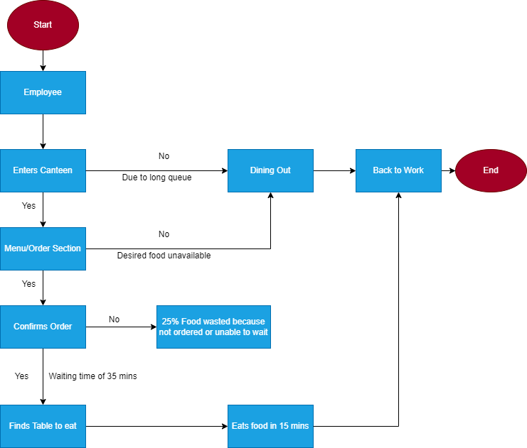
Task 4: As-Is and future state process maps
AS-IS/CURRENT STATE OF THE PROCESS
FOR VIEW

Slide 13
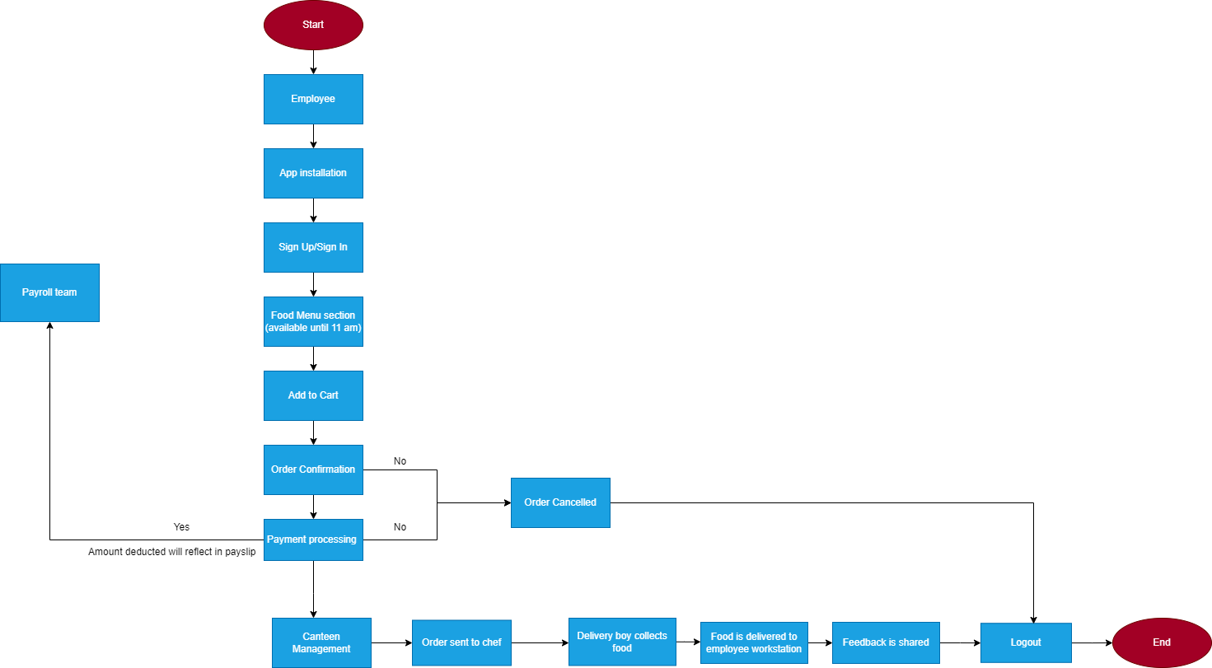
FUTURE STATE OF THE PROCESS
FOR VIEW
FOR LIVE VIEW

Slide 14
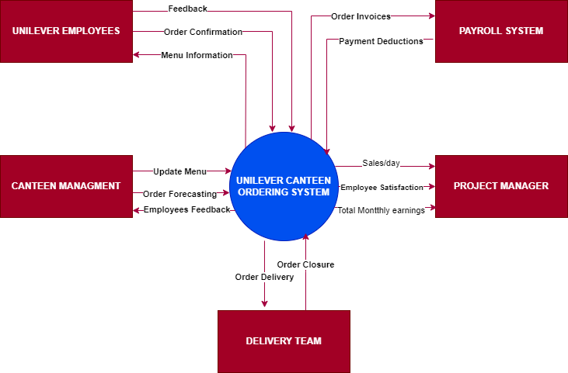
Task 5: Scope of the canteen ordering system
FOR VIEW
FOR LIVE VIEW

Slide 15
Task 6: Features to be developed
Employee registration with secure login credentials
Menu management functionality to update the list of dishes offered each day
Option for employees to select and edit their food orders before final confirmation
Restriction on editing the order after it has been confirmed in the system
Capability for the canteen manager to view incoming orders and assign them to the chef for preparation
Feature for the canteen manager to assign a delivery associate for desk delivery
Delivery associate can close the order in the system after successful delivery
Feedback mechanism to collect employee reviews regarding the food and service
Integration with payroll system to calculate food expenses per employee and deduct the amount from their salary
Automated report generation and submission to management for tracking and analysis

Slide 16
Task 7: In-scope and out of scope for software
In scope requirements
Employee sign up/sign in
Menu page
Meal ordering screen
Order confirmation screen
Order status page
Meal delivery details
Close delivered order by delivery associate
Monthly payroll adjustment
Feedback submission
Sales report for canteen management system
Out of scope requirements
Food vendor management
Food supplies out of stock notification
Canteen staff payment management
Pre-Order requirement
Refund Options
Chef and meal delivery person payment details

Slide 17
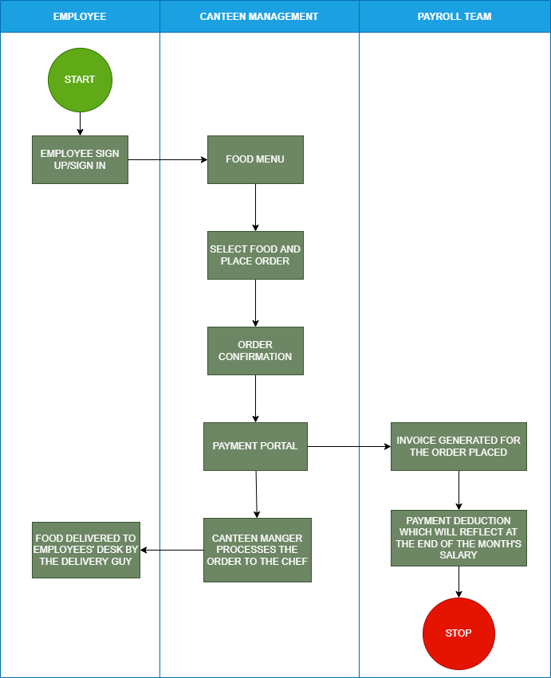
Task 8: Activity diagram for system
FOR VIEW
FOR LIVE VIEW

Slide 18
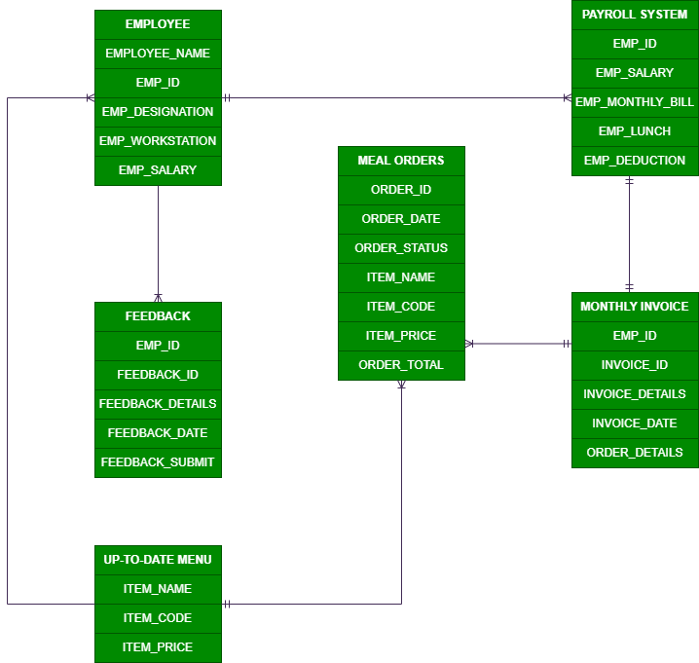
Task 9: ER diagram of canteen ordering system
FOR VIEW
FOR LIVE VIEW

Slide 19
Task 10: Functional and Non Functional business requirements
Functional Business Requirements
Employees must be able to register and securely log in to the system
Canteen staff must be able to update and display the daily menu
System must enforce a cut-off time of 11:00 AM for order placement
Employees should be able to create and edit their orders before checkout
System should enable delivery of orders to employees’ workstations
Delivery associate must be able to mark the order as “Delivered” and close it in the system
System must allow employees to submit feedback after order delivery
Ability to generate analytical reports on canteen usage, order volume, and cost savings for management
Non-Functional Business Requirements
Scalability & Performance: System must support up to 1,500 concurrent users without lag
Availability: System should be lightweight, fast, and responsive even during peak hours
Usability: Interface must be user-friendly, intuitive, and self-explanatory for all employees
Maintainability: The application should be developed in Java, ensuring easy maintenance and updates

Slide 20
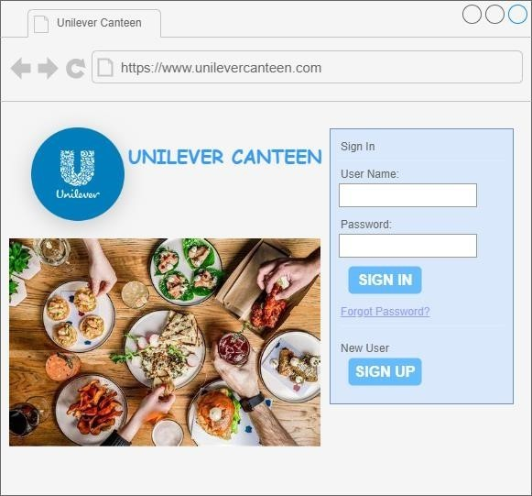
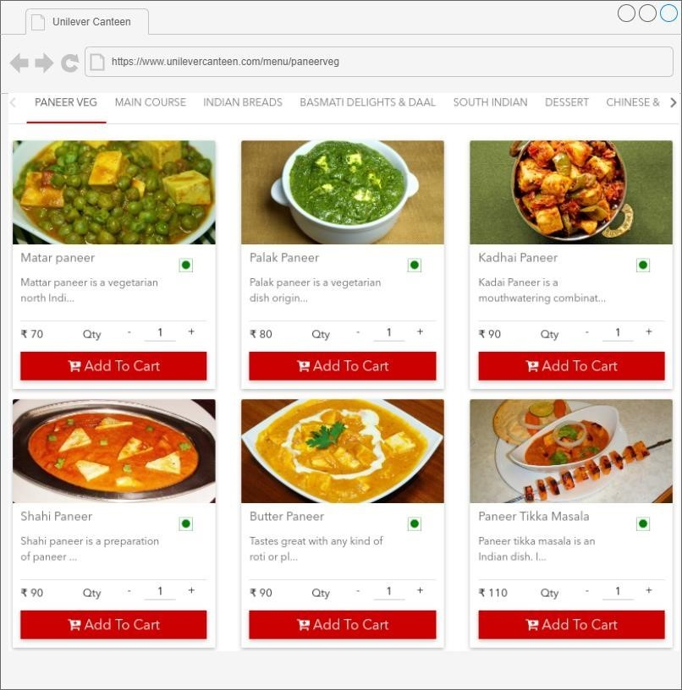
Task 11: Wireframes for canteen ordering system

Slide 21

This Photo by Unknown Author is licensed under CC BY-NC

